Slide 1
High retention in care and virological suppression after Fast-Track ART initiation in the Botswana Combination Prevention Project (BCPP)
Dr. Refeletswe Lebelonyane, P. Bachanas, W. Abrams, M. Roland, J. Theu, M. Kapanda, S. Matambo, S. Lockman, J. Moore, L. Block, T. Gaolathe, J. Makhema, J.N. Jarvis
Botswana Ministry of Health and Wellness, Gaborone, Botswana
Centers for Disease Control and Prevention, Division of Global HIV/AIDS and TB, Atlanta, United States,
Harvard T.H. Chan School of Public Health, Boston, United States,
Centers for Disease Control and Prevention; Botswana Harvard Partnership; & Botswana-UPenn Partnership, Gaborone, Botswana

Slide 2
BACKGROUND
Despite high ART coverage, HIV incidence in Botswana remains high - 1.35% (Botswana Impact AIDS Survey 2013)
This is despite Botswana being close to achieving 90-90-90 coverage targets:
83-87-96 in 2016 (Gaolathe at.al)
Continued high incidence of HIV transmission may be the result of insufficient scale, coverage and quality of proven intervention methods.
Botswana Combination Prevention Project (BCPP/Ya Tsie) is a cluster randomized community trial evaluating the impact on HIV incidence of a combination prevention package including:
Rapid scale-up of HTC and linkage to care services >90%
Rapid scale-up of universal ART >93%
Rapid scale-up of retention in care and adherence intervention >95%

Slide 3
BACKGROUND (2)
Fast-tracked ART initiation addresses the UNAIDS 2nd 90 (rapid scale up of universal ART)
It is not known whether Fast-Track ART initiation has any significant effects on individual HIV treatment outcomes – beneficial or detrimental
Fast-Track ART initiation may also have population-level effects, by resulting in more rapid virologic suppression
BCPP implemented Universal Test and Treat (UTT) and Fast-Track ART initiation with enhanced counseling and ART offered at the first clinic visit following the national launch of UTT in June 2016
Prior to UTT/Fast-Track, Botswana national guidelines recommended baseline blood tests and adherence counseling before ART initiation requiring a minimum of 2-3 visits.
We compared outcomes pre- and post- Fast-Track ART (June 2016)

Slide 4
METHODS
Of the 30 BCPP communities, 15 are intervention and 15 control.
This sub-analysis focuses on the 15 intervention communities and evaluates:
The cohort of patients identified through enhanced BCPP testing and linkage activities between October 2013 and May 2016 initiating ART according to modified national guidelines and visit schedules , and
Patients initiating ART following UTT introduction, 1 June 2016 - 31 December 2017. During this period, all participants with a positive HIV verification test were immediately referred for ART initiation.
The proportion of patients initiating ART, the timing of ART initiation, and treatment outcomes were assessed (retention in care at 12 months post ART initiation, viral suppression at 12 months Post ART initiation)

Slide 5
Results Slide 1
61,641 community residents assessed

Slide 6
Results Slide 1
61,641 community residents assessed
21% (13,251) HIV +ve

Slide 7
Results Slide 1
73% (9,622) Already on ART
61,641 community residents assessed
27% (3629) NOT ON ART
21% (13,251) HIV +ve

Slide 8
Results Slide 1
73% (9,622) Already on ART
61,641 community residents assessed
27% (3629) NOT ON ART
21% (13,251) HIV +ve

Slide 9
Results Slide 1
73% (9,622) Already on ART
61,641 community residents assessed
27% (3629) NOT ON ART
21% (13,251) HIV +ve
93% (3360) LINKED
2342 Pre-Fast Track
(84%)
1965 Eligible* for ART
1013 Fast Track
1013 Eligible for ART
Median time from study intake to clinic linkage was 7 days pre-UTT and 5 days post-UTT

Slide 10
Patient Characteristics (of the 3629 HIV +ve individuals not on ART)
Results Slide 2
 | Pre Fast Track | Fast-Track | P-value
n | 1965 | 1013
Dates | Nov 2013-May 2016 | June 2016-May 2018
Age (years) | 36 (29-45) | 32 (IQR 26-40) | < 0.001
Sex (% Female, n) | 62% (1228) | 56% (562) | < 0.001
Baseline CD4 count (cells/µL) | 334 (214-467) | 349 (145-560) | 0.3
New HIV diagnosis (%, n) | 52% (1032) | 65% (658) | < 0.001
Prior ART (%, n) | 4% (82) | 5% (46) | 0.6

Slide 11
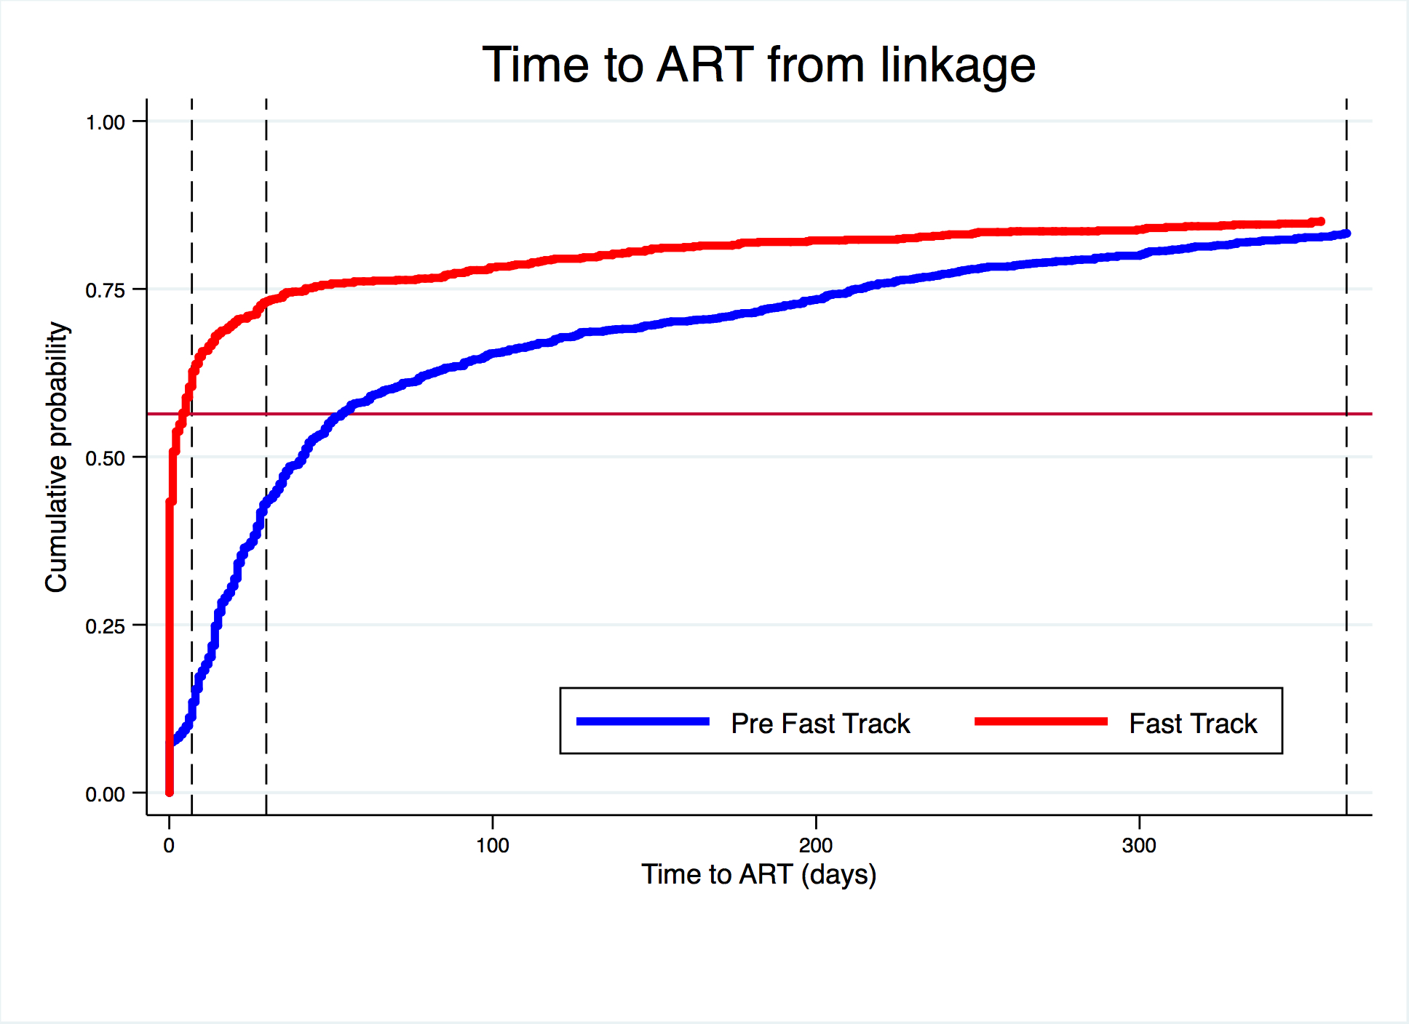
ART initiations occurred more quickly after implementation of Fast-Track ART
Results Slide 3
The cumulative probability of initiating ART within one year was 83% in the pre Fast Track group and 85% in the Fast Track group
1 month
Time from linkage to ART in those who initiated*
1 week
1 year
Time from linkage | Pre Fast Track (1964) | Fast-Track (1008)
1 day | 7% (113) | 60% (511)
1 week | 16% (265) | 73% (621)
1 month | 52% (855) | 87% (736)
1 year | 100% (1638) | 100% (846)
*The denominator is those initiating within first year of linkage
P < 0.0001
Notes:
A higher proportion started ART by one year post fast track, and they started much more quickly

Slide 12
Rates of retention in care and virological suppression were high with Fast-Track ART
Results Slide 4
Pre Fast-Track
Fast-Track
Linked & Eligible
1965
Linked & Eligible
1013
Initiated ART > 6 months ago
1844
Initiated ART > 6 month ago
816
Retained on ART
1736/1844 (94%)
Retained on ART
756/816 (93%)
VL≤400*
1579/1608† (98%)
VL≤400*
694/704† (99%)
*Within First Year of ART initiation
†Viral loads were available for 1608/1736 (93%), 704/756 (93%), and 455/470 (89%) of individuals in the pre-fast track, fast track, and same day cohorts respectively
Notes:
Now looking just at those who initiated ART at least 6 months prior to data censoring to assess retention and virological suppression with standard and fast track initiation..

Slide 13
Rates of retention in care and virological suppression were high with Fast-Track ART
Results Slide 4
Pre Fast-Track
Fast-Track
Linked & Eligible
1965
Linked & Eligible
1013
Initiated ART > 6 months ago
1844
Initiated ART > 6 month ago
816
85.6% Retained on ART, had a VL, & suppressed
85.0% Retained on ART, had a VL, & suppressed
Retained on ART
1736/1844 (94%)
Retained on ART
756/816 (93%)
VL≤400*
1579/1608† (98%)
VL≤400*
694/704† (99%)
*Within First Year of ART initiation
†Viral loads were available for 1608/1736 (93%), 704/756 (93%), and 455/470 (89%) of individuals in the pre-fast track, fast track, and same day cohorts respectively
Notes:
WORST CASE SCENARIO. Many of those without a VL were probably suppressed. If you apply the % suppression rate to those retained, the equivalent figures are 92% & 91%.

Slide 14
Rates of retention in care and virological suppression were high with Fast-Track ART
Results Slide 4
Pre Fast-Track
Fast-Track
Linked & Eligible
1965
Same Day ART
Initiated ART > 6/12 ago
503
Initiated ART > 6 months ago
1844
Retained on ART
470/503 (93%)
89.1% Retained on ART, had a VL, & suppressed
85.6% Retained on ART, had a VL, & suppressed
Retained on ART
1736/1844 (94%)
VL≤400*
448/455† (98%)
VL≤400*
1579/1608† (98%)
*Within First Year of ART initiation
†Viral loads were available for 1608/1736 (93%), 704/756 (93%), and 455/470 (89%) of individuals in the pre-fast track, fast track, and same day cohorts respectively

Slide 15
Time from linkage to first viral suppression was significantly shorter following introduction of Fast-Track ART
Results Slide 5
Pre Fast Track: median 210 days from linkage to suppression
Fast Track: median 104 days from linkage to suppression
P < 0.001

Slide 16
Time from linkage to first viral suppression was significantly shorter following introduction of Fast-Track ART
Results Slide 5
Pre Fast-Track: median 210 days from linkage to suppression
Fast-Track: median 104 days from linkage to suppression
P < 0.001
Fast-Track ART was safe and well tolerated:
- 26 deaths (1.32%) in the year following linkage pre Fast Track
- 9 deaths (0.9%) in the year following linkage Fast Track
9 (1.4%) patients initiating ART within the first week (pending blood results) during the Fast Track period had an abnormal creatinine clearance (< 60 µmol/L), 6 of whom were on ART at 1 year, and 3 of whom died
P = 0.3

Slide 17
CONCLUSIONS
Fast-Track ART was acceptable and feasible and led to increased rates of ART initiation and markedly reduced times from initial clinic visit to treatment start.
Rates of retention in care at one year were as high in Fast-Track as pre Fast-Track.
Virological suppression rates at 12 months post Fast-Track ART initiation very were high.
Virological suppression was achieved twice as fast (median 104 vs. 210 days) which may have individual and population-level transmission benefits.
These findings demonstrate that Fast-Track ART initiation does not lead to lower retention in care or lower rates of virological suppression at one year.
Fast-Track ART led to equivalent or improved rates of ART initiation, retention in care, and virological suppression compared to prior practice, and could help ART programs in Africa reach the ambitious UNAIDS 90-90-90 targets.

Slide 18
Acknowledgements
BCPP Participants BCPP Study Team HSPH Molly Pretorius Holme Max Essex Shahin Lockman Kathleen Wirth Eric J. Tchetgen Tchetgen Kara Bennett Jean Leidner Kathleen Powis Vlad Novitsky Scott Dryden-Peterson Victor DeGruttola Quanhong Lei Rui Wang Hermann Bussmann Roger Shapiro | BHP Joseph Makhema Mompati Mmalane Tendani Gaolathe Etienne Kadima Unoda Chakalisa Sikhulile Moyo Mosepele Mosepele Kutlo Manyake Coulson Kgathi Erik van Widenfelt Atang Mbikiwa Rona Letlhogile S. Vinoliah Simon Oaitse John Kutlwano Mukokomani Lillian Okui Ria Madison | CDC Janet Moore Pamela Bachanas Lisa Block William Abrams Mary Grace Alwano Tafireyi Marukutira Lisa A. Mills Gene Ussery Aaron Miller Huisheng Wang Faith Ussery Michelle Roland Connie Sexton Joseph Jarvis MOH Shenaaz el-Halabi Joe Theu Thandie Phindela Tony Chinani
Participating Institutions: Harvard T.H. Chan School of Public Health, Botswana-Harvard AIDS Institute Partnership (BHP), Centers for Disease Control and Prevention (CDC), Botswana Ministry of Health (MOH)
Funded by the U.S. President’s Emergency Plan for AIDS Relief (PEPFAR) and the Office of the Global AIDS Coordinator (OGAC)
Sponsored through the U.S. Centers for Disease Control and Prevention (CDC)

